Slide 1
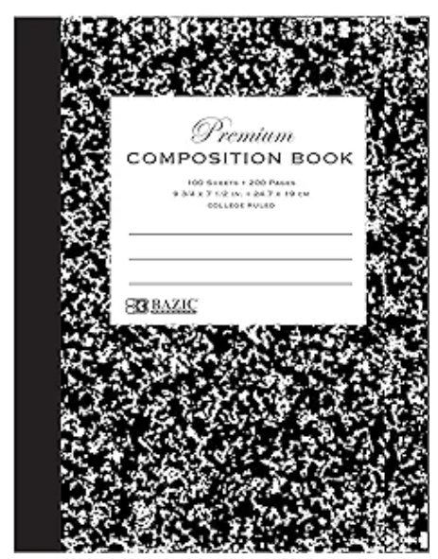
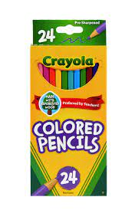
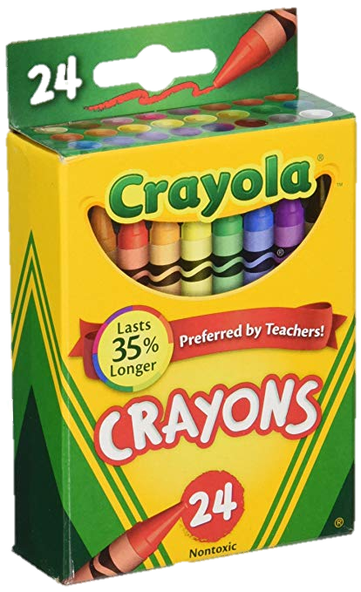
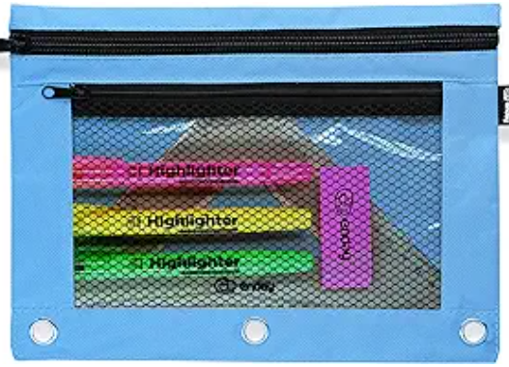
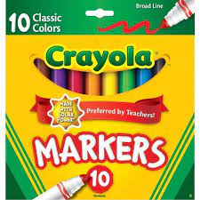
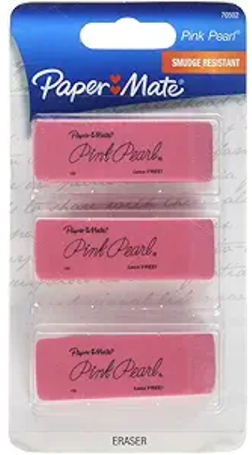
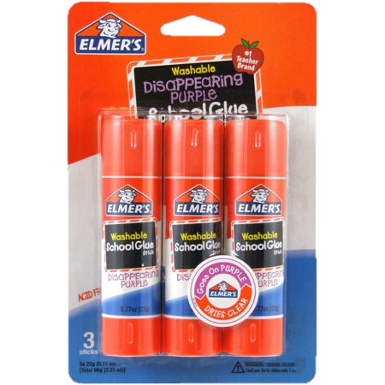
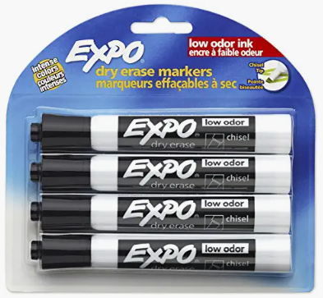
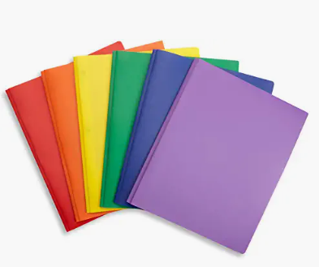
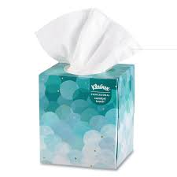
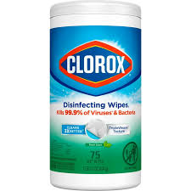
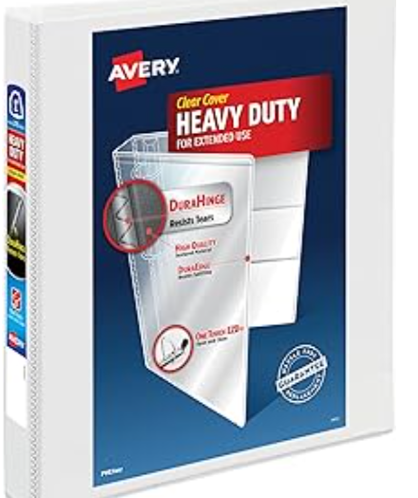
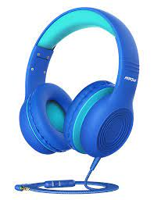
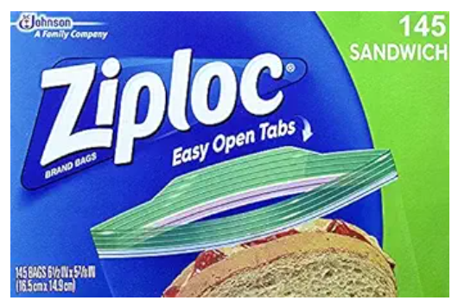
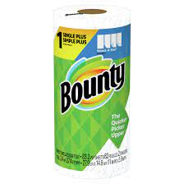
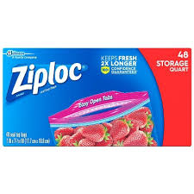
second grade
Rolesville Elementary
2024-2025 Supply List
2 – Hard Cover One Subject Composition Notebook | Crayola Colored Pencils AND Markers | 1 Box of Crayola Crayons | 1 Soft Pencil Pouch
1 Box of Sharpened Pencils AND Erasers | 1 Pack of Glue Sticks | At least 5 Black Expo Dry Erase Markers | 2- 3 Prong Plastic Folders- Red and Green ONLY
Headphones (label with child’s name – NO EARBUDS) | 1 box of tissues | Clorox Wipes | 1 – One Inch Binder
Girls Please Bring: Hand Sanitizer Sandwich Size Bags |  | Boys Please Bring: Quart Size Bags Paper Towels
**Please bring your supplies to the first day of school in August!
**Each student needs to bring their own water bottle labeled with their name!
Notes:
Folders: Phonics, Writing, Catch Up, Take Home Math Folder

